Slide 1
France vs. Britain
The Seven Year War

Slide 2
France and Britain were often rivals for different colonies in many parts of the world for military & naval power
When France and Britain were at war, all their colonies were affected as well
There were three main areas in North America that France and Britain had conflict in:

Slide 3
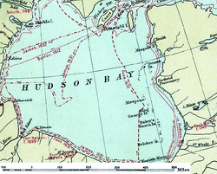
Trouble Spot #1:
Hudson Bay

Slide 4
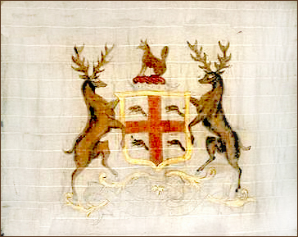
1670: the British founded the Company of Adventurers of England Trading more commonly known as the Hudson’s Bay Company!
They built forts where major rivers flowed into Hudson & James Bay in an attempt to “tap in” to the beaver fur of the Northwest

Slide 5
The French made a series of successful, armed attacks on British posts but never gained control of Hudson Bay
The French built posts on Lake Winnipeg and the Saskatchewan River
They convinced the Cree people to trade with them instead of the British
This enabled the French to take fur that would have otherwise gone to the British

Slide 6
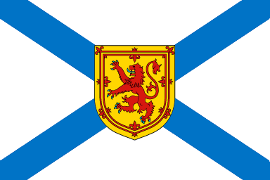
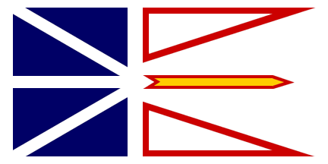
Trouble Spot #2:
Nova Scotia and Newfoundland

Slide 7
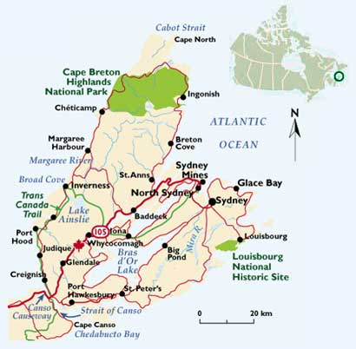
Britain and France have exchanged Nova Scotia and Newfoundland in many peace talks
France only kept Ile Royale (Cape Breton), Ile St-Jean (PEI) and fishing rights along the North shore of Newfoundland

Slide 8
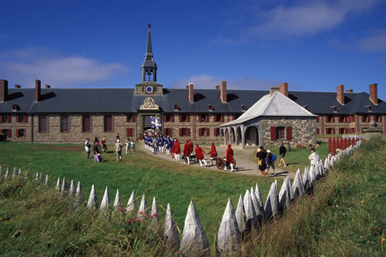
Fort at Louisbourg

Slide 9
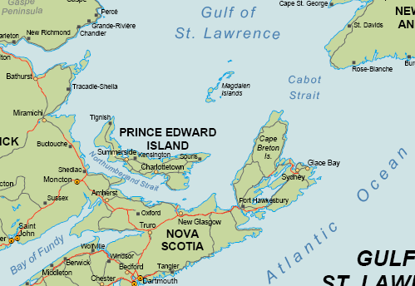
1720: French were being oppressed by the British so they decided to build a fortress – Ile Royale at Louisbourg
Built to protect the French fishing base/fleets and guarded the entrance to the Gulf of St.Lawrence
St.Lawrence was the main route to France and needed to be available at all times

Slide 10
The fortress was built like a European castle with a moat and bastions with 148 cannons
The fort was extremely expensive to build but New France was determined to protect itself
This was their last piece of territory in the Atlantic

Slide 11
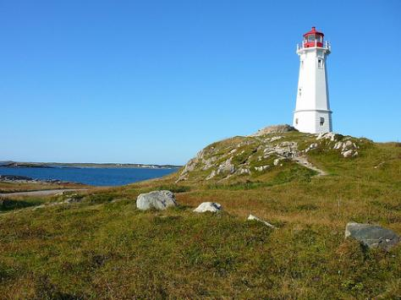
1840: Louisbourg was the centre of the cod fishing industry
Fish were salted and sent to Europe
Canada’s first lighthouse was built in Louisbourg

Slide 12
Louisbourg had no seigneurial system
Small fur trade
Church had less power
Non-French (Germans, Swiss and Basques*) lived and worked together
*people inhabiting spaces between France and Spain

Slide 13
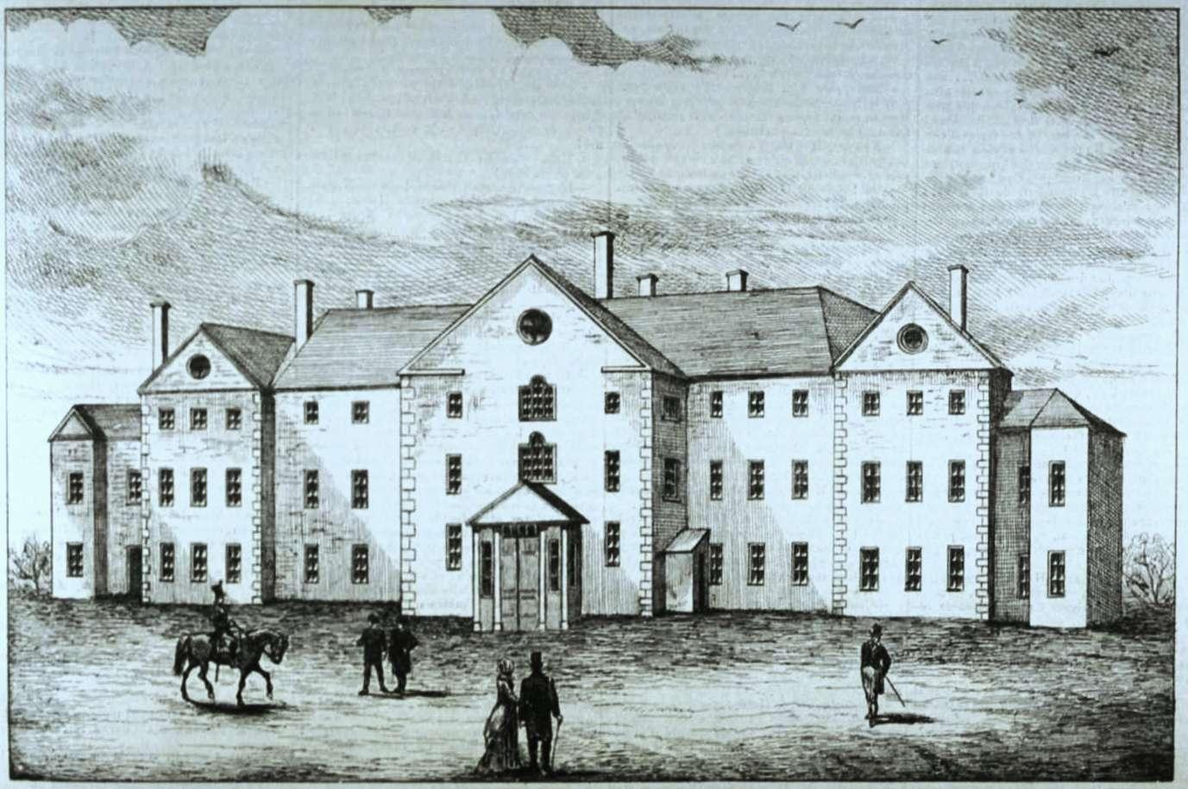
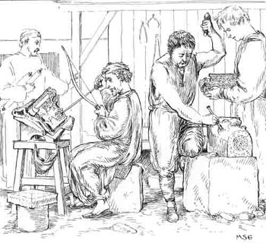
Louisbourg was a “complete” town with:
Government administrators (governor lived at Chateau St-Louis)
Artisans
Fishermen
Innkeepers – there were many inns and taverns near the harbour
A market

Slide 14
Louisbourg – Chateau st-Louis
Chateau St-Louis today is in ruins, and a tourist location. It was destroyed in a fire in the 1834.

Slide 15
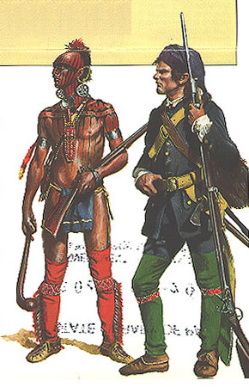
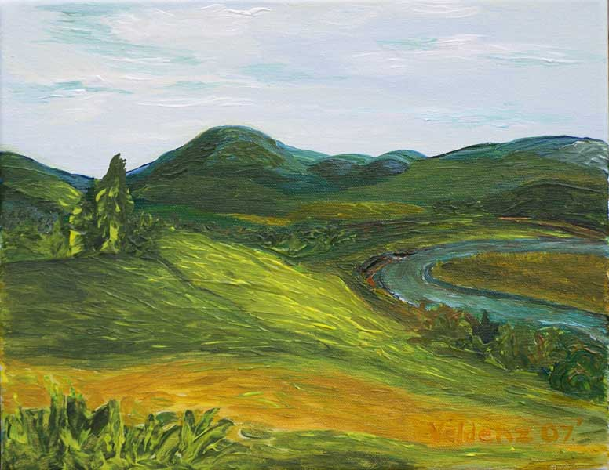
Trouble Spot #3:
The Ohio River Valley

Slide 16
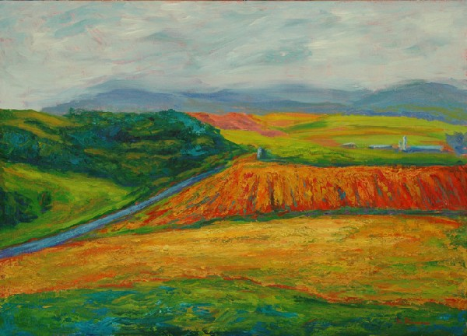
Both France and Britain saw the Ohio River Valley as the key to dominating North America
Land was very fertile and sought after

Slide 17
British wanted the French out of the area and were ready to drive them out by force
French didn’t want to leave so the British used the same technique as in Hudson Bay… they convinced the Cree people not to trade with the French
British expanded southward and cut off French access to Louisiana

Slide 18
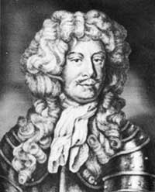
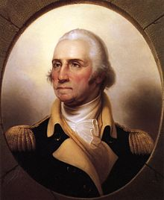
Governor Duquesne sent troops to reinforce the area – Aboriginals joined the French side as well
George Washington moved into the area in 1754 but the French acted quickly and the Americans surrendered

Slide 19
The French had to keep their Aboriginal allies supplied with trade goods
They also had to feed and support the French troops
This became a great drain on the French resources

